Slide 1
Sked App
Sriram Elango Prathamesh Raje
A20343102 A20353716

Slide 2
Abstract
The Sked is a scheduler android application that could be used to schedule meetings, events or meetups for a group of people. It helps a group of people to decide a particular day and time that is common to maximum people in the group. This helps in collaborating in groups with respect to scheduling.
The application takes input as a set of time slots for specific days (up to 3) from users. These specific days are mentioned by the creator of the group. Then the application asks each user to provide up to five suitable time slot for each day. Then the application evaluates and suggests the most common time when all or maximum peer/members are available on a particular day.
Thus, the application helps to suggest a common day possible for maximum peers, members or friends to meet up for an event. The app provides notifications (in notification bar with sound and vibrations) to the user when an event he/she enrolled in is scheduled. The app also helps the user to view the event location/venue in Google Maps inside the application itself.

Slide 3


What is SKED?
The Sked app is a scheduler android application that could be used to schedule meetings, events or meetups for a group of people.
Sked app evaluates and suggests the most common time when maximum peers/members are available on a particular day.
Sked can be used by any type of user and for planning or collaborating for a formal/informal meetings, parties, get together, meet ups, sports practice, etc.

Slide 4

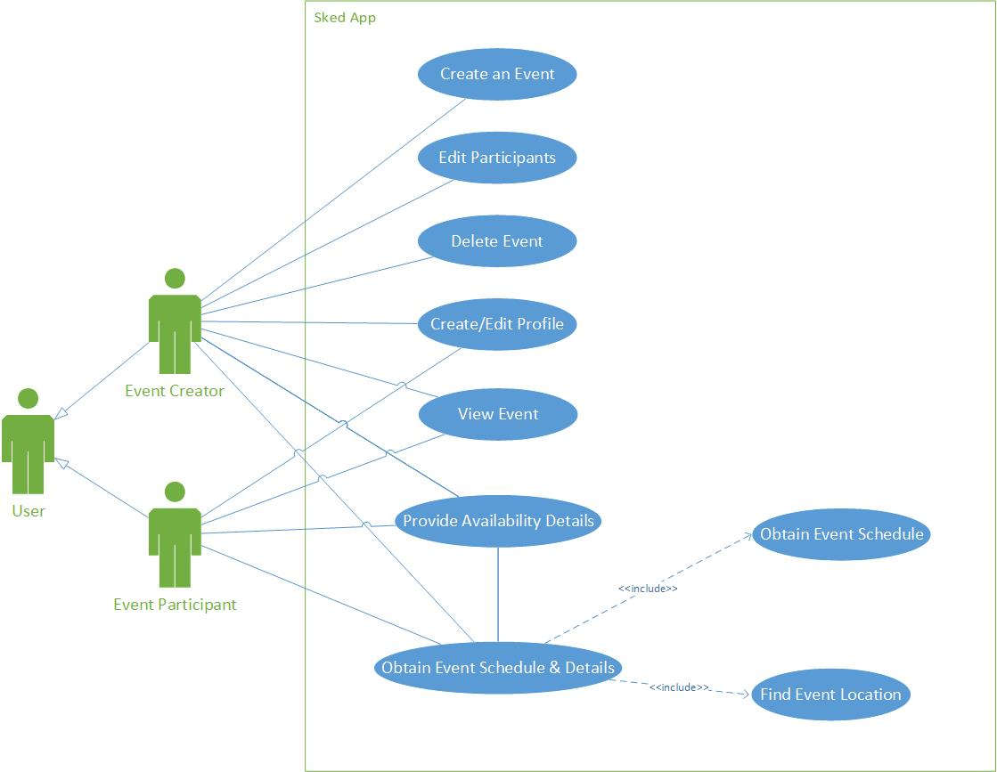




UML / Use Case Diagram

Slide 5
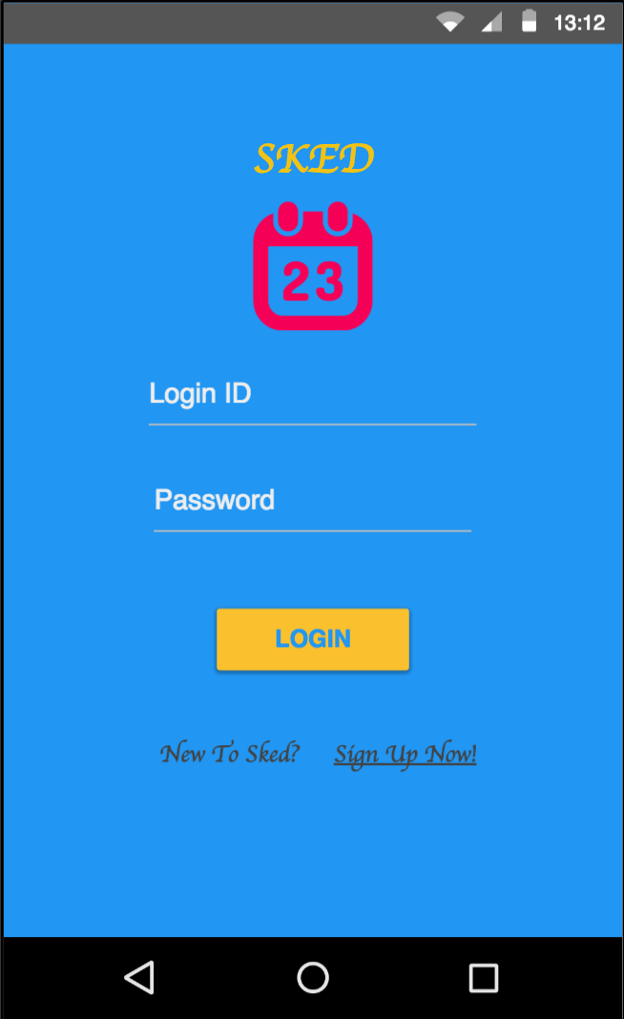
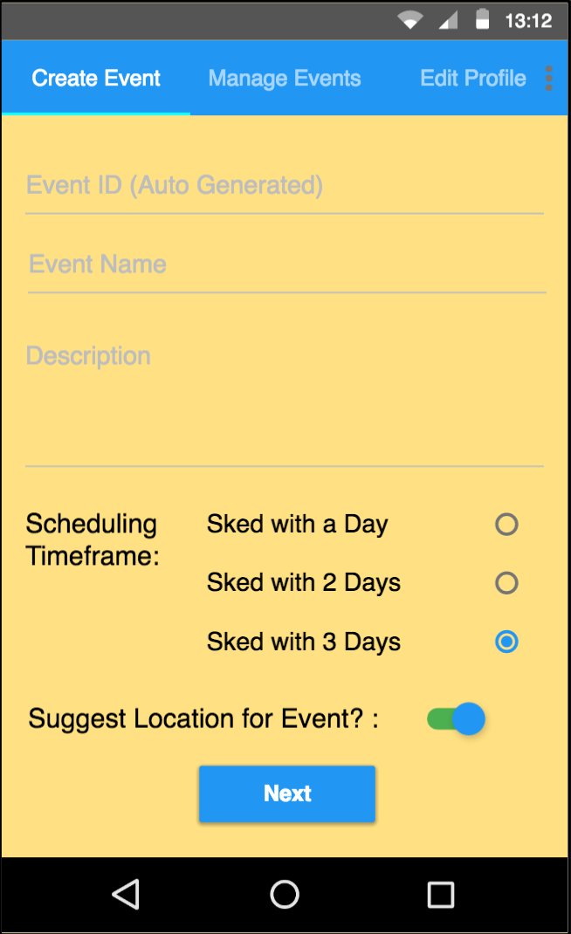
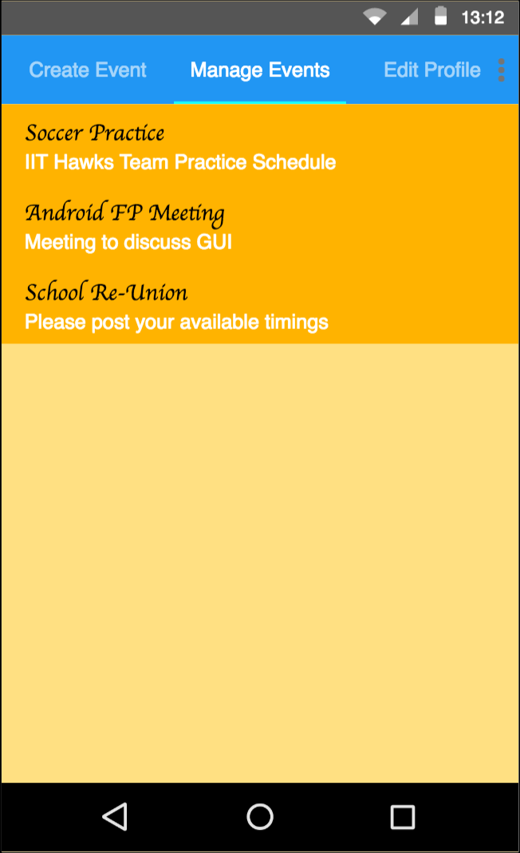
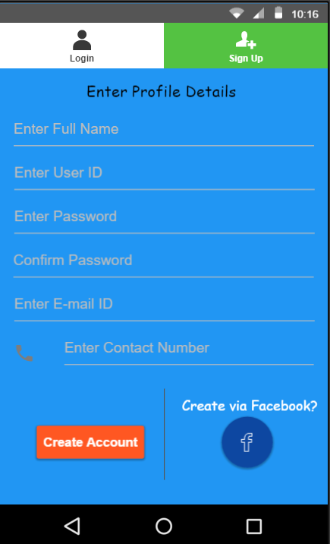
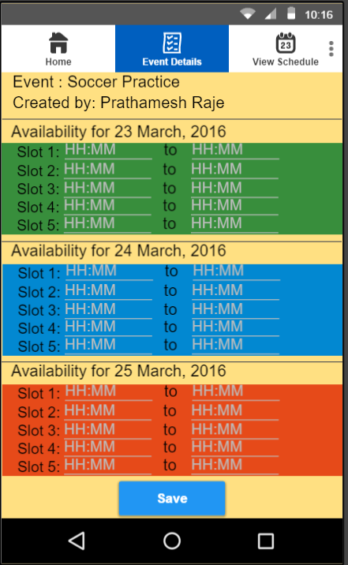
Prototype

Slide 6
Design Components
Swipe embedded with Tabbed View
Map View
Swipe Refresh Layout
SQLite Database
Google Maps API
Google Places API
Notification Manager
Scroll View

Slide 7
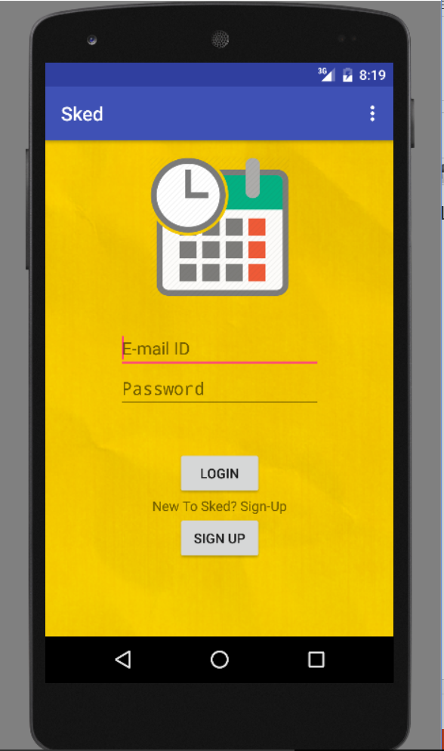
Functionality and Screenshots
Login Activity
This is the main activity when the app loads.
The User can login with his existing account or a new User can create a new account using signup button.
Java Class: LoginActivity
XML Layout: content_login.xml

Slide 8
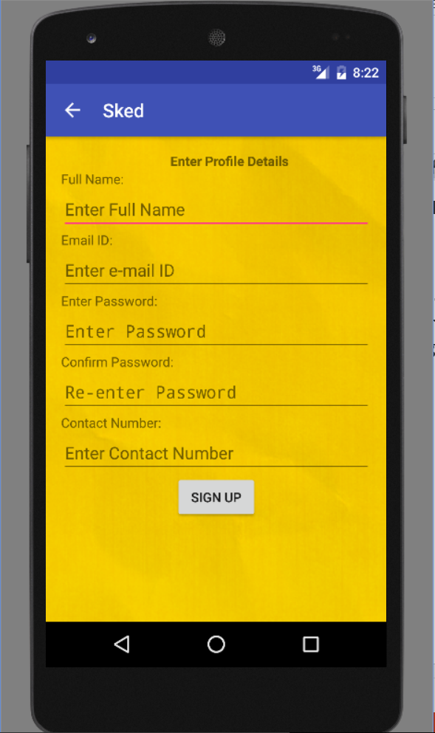
Functionality and Screenshots
SignUp Activity
This activity loads when User clicks the Signup button in the Login activity.
The User register a new account by entering the details. Validations for all the fields is done. Java Class: SignUp.java
XML Layout: content_sign_up.xml

Slide 9
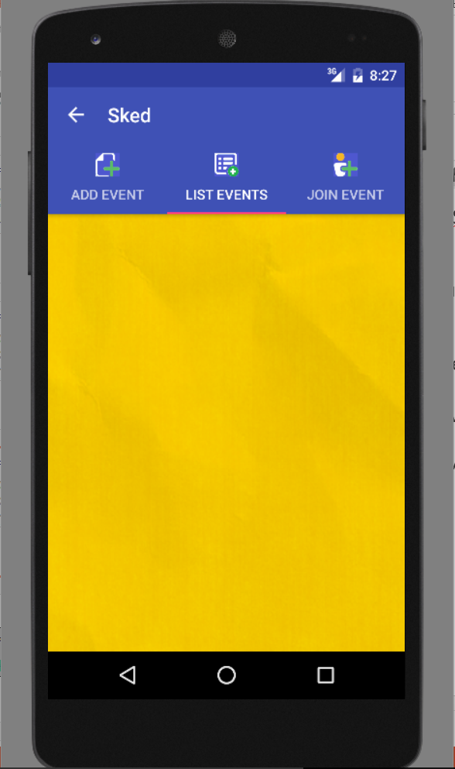
Functionality and Screenshots
Home Activity
This is the home activity that is visible to the user after successful login. It consists of Swipe embedded tabbed view as shown in the screenshot.
The user can swipe or click on the tabs to switch between various options (fragments) Java Class: EventHomeActivity.java
XML Layout: activity_event_home.xml

Slide 10
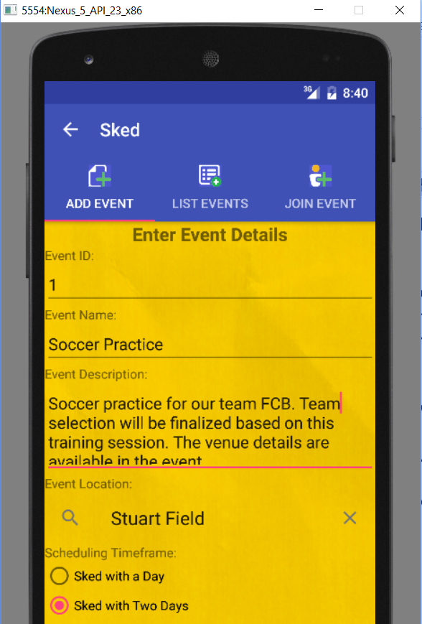
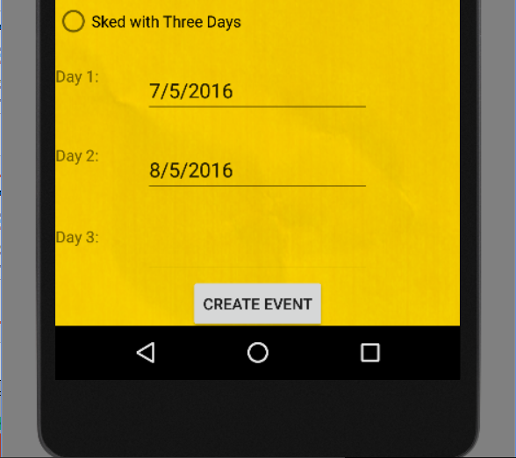
Functionality and Screenshots
Add Event Fragment
This is a fragment within the home activity that helps user to add a new event. The Event location edit text field is a auto complete fragment that uses Google Places API to suggest places depending on the text entered.
The Day 1, Day 2 and Day 3 edit text fields are dependent on the Radio Group “Timeframe”. Based on the selected radio button the Day edit text fields are enabled. Java Class: OneFragment.java
XML Layout: fragment_one.xml

Slide 11
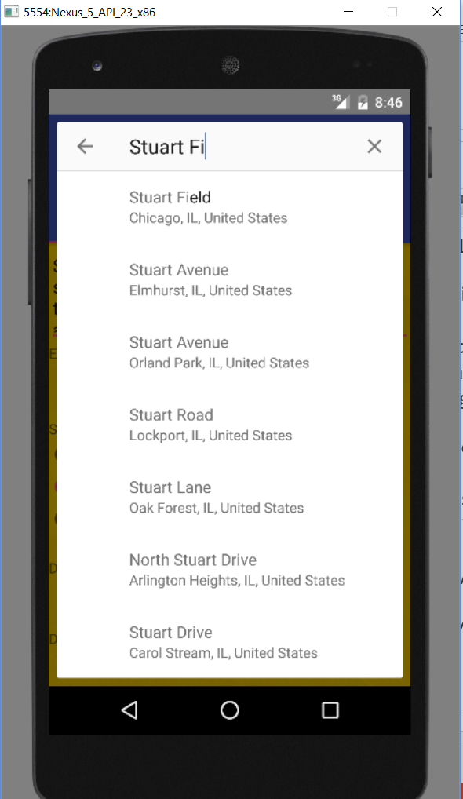
Functionality and Screenshots
Google Places API/ AutoComplete Fragment
When the user clicks on the location edit text box in the Add Event page, the auto complete fragment captures the entire screen and suggests the places according to the user entry.
Kindly refer the screenshot as shown:

Slide 12
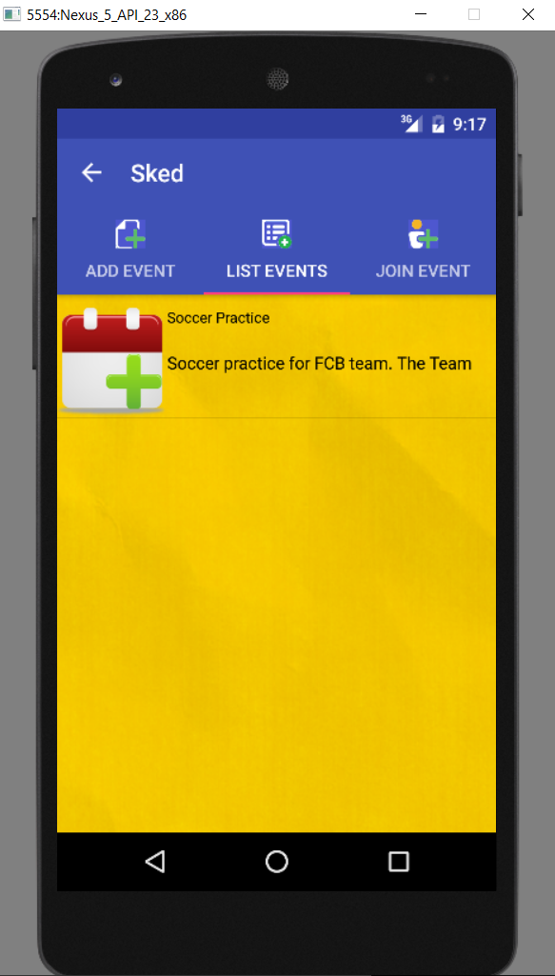
Functionality and Screenshots
List Events Fragment
This activity displays the list of event in List View fetched from the database. Only the event to which the logged in user is registered is shown in the list. The list view is clickable and the respective event details are displayed further.
Kindly refer the screenshot as shown:
Java Class: TwoFragment.java
XML Layout: fragment_two.xml

Slide 13
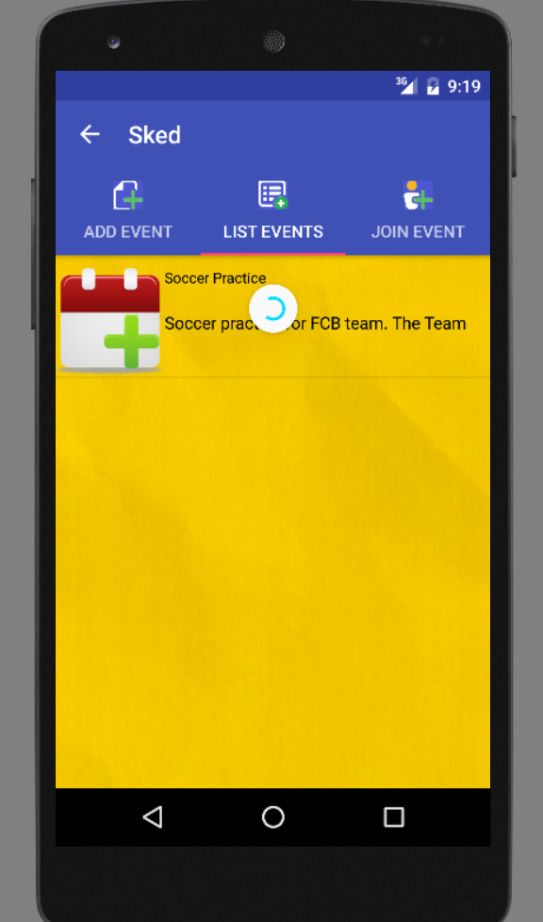
Functionality and Screenshots
Swipe Refresh Layout
Swipe Refresh is used to refresh the list of events dynamically. This enables the user to load the list of events without closing the app of switching between activities.
Kindly refer the screenshot as shown: You can see the refresh bar when the screen was swiped.

Slide 14
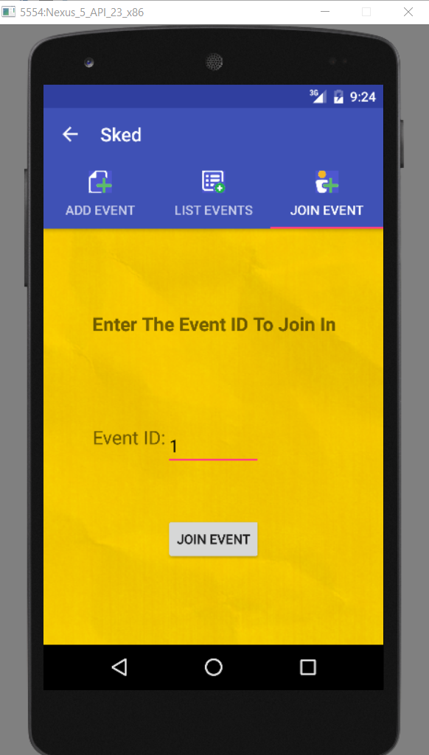
Functionality and Screenshots
Join Event Fragment
Using this fragment user can join an existing Event by providing the event id in the edit text field.
Kindly refer the screenshot as shown:
Java Class: ThreeFragment.java
XML Layout: fragment_three.xml

Slide 15
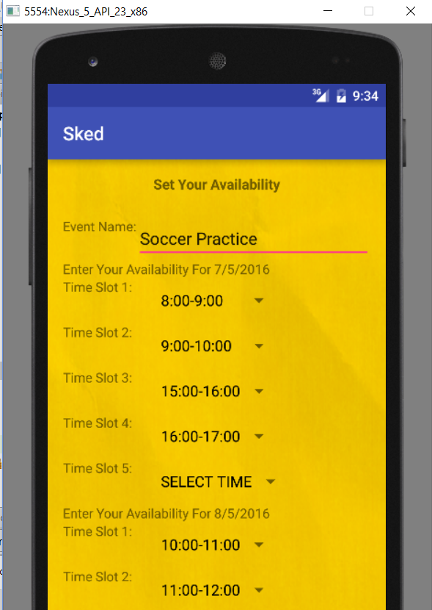
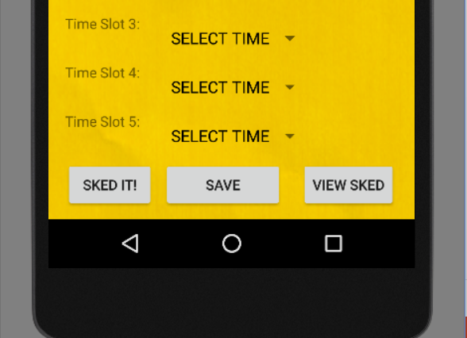
Functionality and Screenshots
Event Details Activity
This screen helps users to input their availability details/ preferences. Based on the days of Sked the days and time slots are loaded in this activity. The Sked It button schedules the event by taking the availability of all users in that event. This option is only clickable by the organizer of that event. The Save button saves the preferences of the availability and the View Sked button displays the Schedule of that event, only if it is Sked by the organizer.
Kindly refer the screenshot as shown:
Java Class: EventDetails .java
XML Layout: activity_event_details.xml

Slide 16
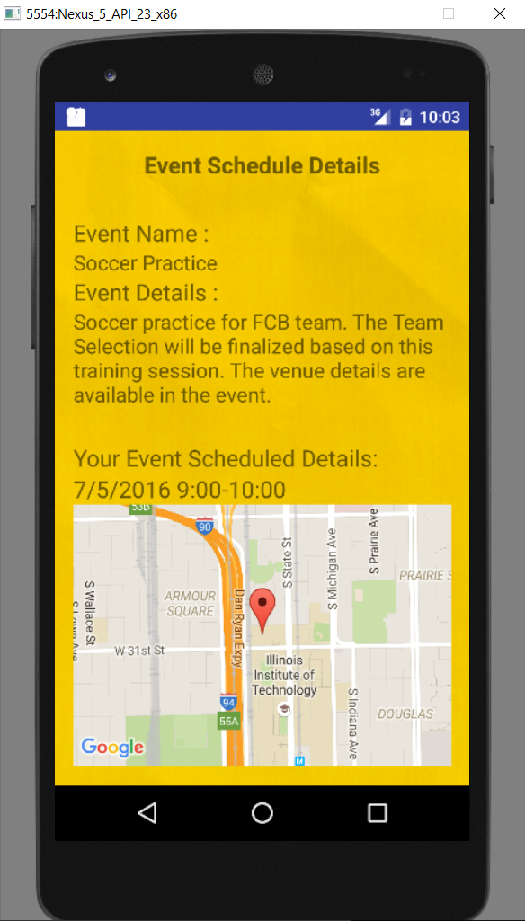
Functionality and Screenshots
Event Schedule Details Activity
This screen displays the event schedule details to all the participants of the event. The map view display the location with pin on it. The location is retrieved from the stored latitude and longitude values from the database that were converted from the address entered by the event organizer.
Kindly refer the screenshot as shown:
Java Class: ViewSchedule.java
XML Layout: activity_view_schedule.xml

Slide 17
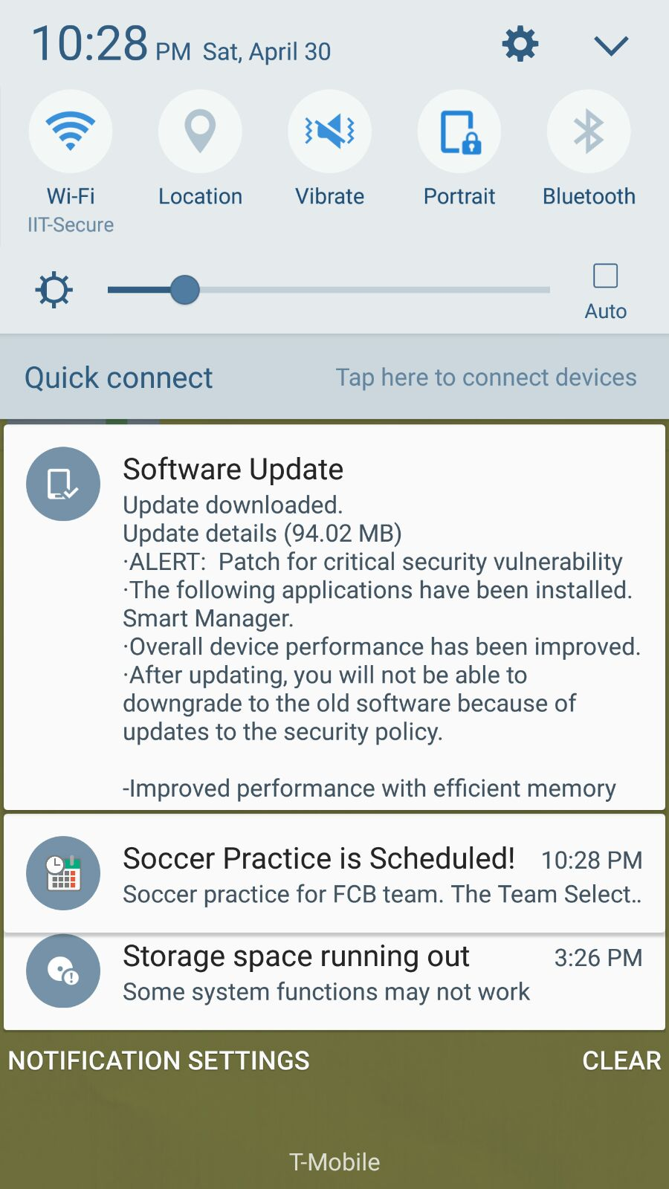
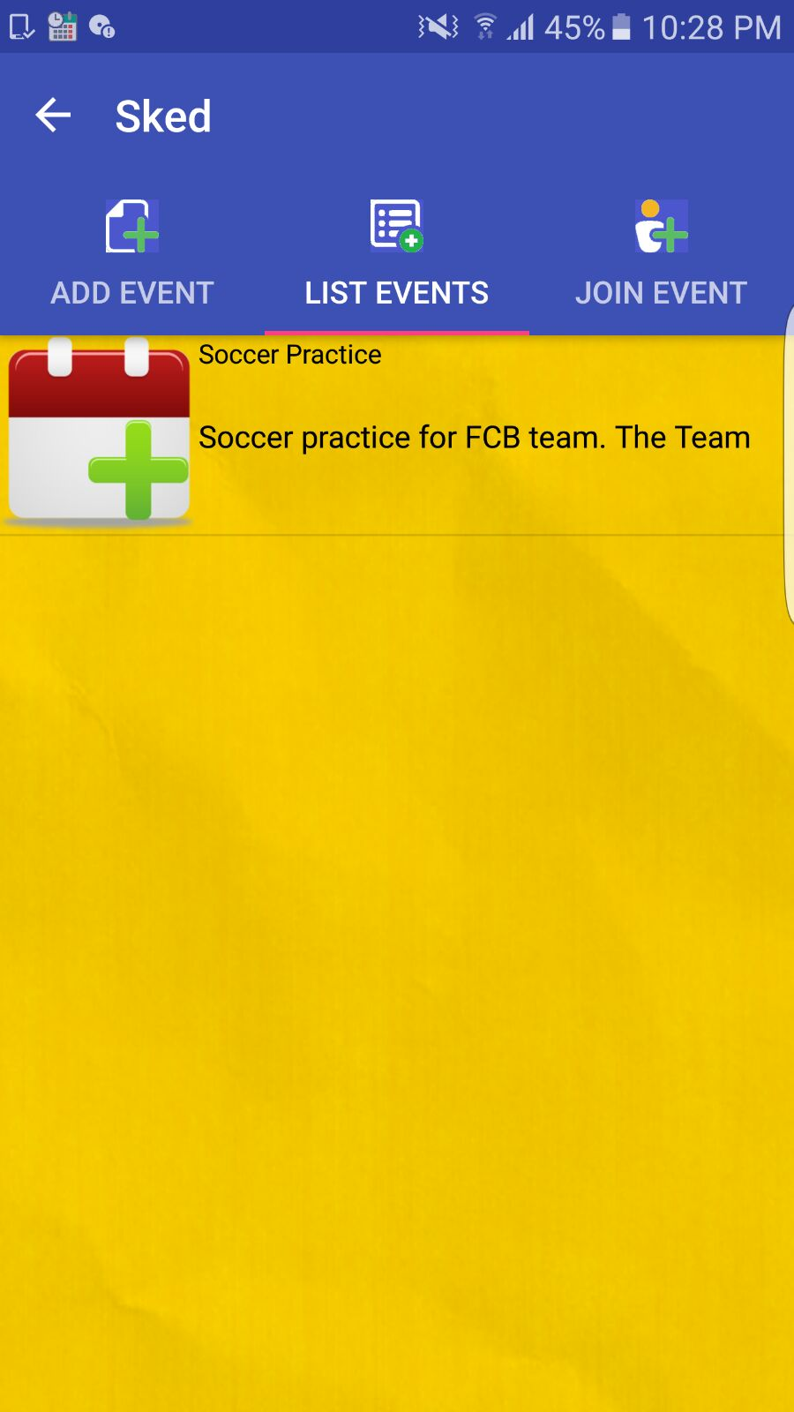
Functionality and Screenshots
Notification Bar
As shown in the screenshots, once the event is scheduled, a notification appears in the android notification bar, with sound and vibration. The notification shows the Event name and description of the event that is scheduled.

Slide 18
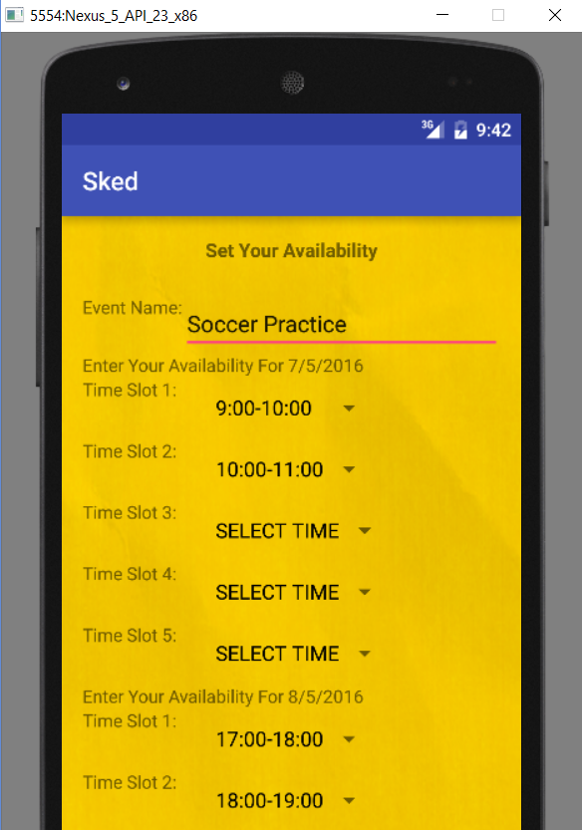
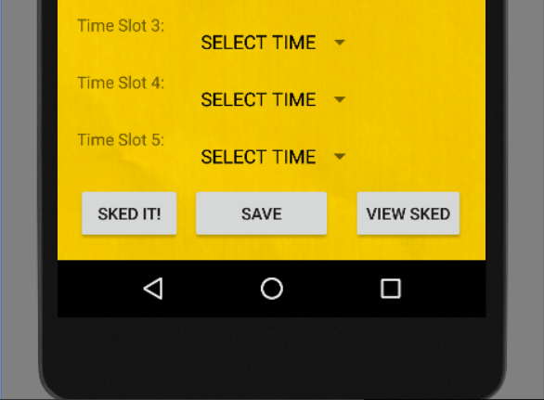
Functionality and Screenshots
Analysis of the Algorithm
USER 1
USER 2

Slide 19
Functionality and Screenshots
Analysis of the Algorithm
Thus shown in the previous slide, both the users have common time as 9:00-10:00 on 7/5/2016. That is the only time common between both.
That is how the logic finds the common day and time between multiple users.

Slide 20
Conclusion
Thus, the Sked application helps to find out a common date and time for group of people to meet or come together for an event, meeting, parties, or any other activities.
It also serves as a meeting calendar with location and meeting details in the summary of the event. The location could help the users to find the venue of the event. While the event details give a brief idea about the event.
The Sked app saves time and efforts spent in coordinating within a huge group.
The app is user friendly with good and easy to use UI components. It also provides notifications as reminders to the user.

